Slide 1
Survey of OS process scheduling
Charles Melis - A20519854
PHD Student : Luke Logan
04/26/2023

Slide 2

Overview :
Introduction
Background
Discussion
Conclusion

Slide 3

Introduction
The need to study OS process scheduling in HPC become more and more important
HPC systems needs to process large amounts of data and perform complex computations efficiently and effectively
To do so they require an efficient CPU scheduling algorithm and an efficient management of resources
This survey aims to provide a comparison of multiple OS Process schedulers classified by categories.

Slide 4
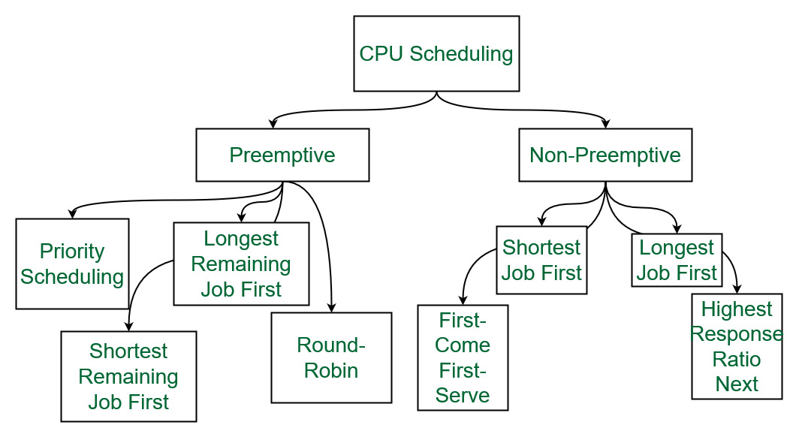
II. Background
Linux has 2 types of processes :
Real-time processes : cannot be delayed, used in migration of process
Conventional processes : can be delayed if the system is busy
The most common scheduling algorithms

Slide 5





III. Discussion
5 classes of OS process schedulers
General-Purpose
Performance
Energy
Efficiency
Cyber-security
Multi-core oriented

Slide 6
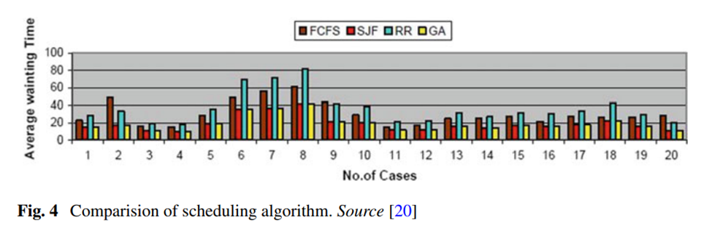
III. General-Purpose
Adapt the evolving needs of data centers
Improve latency, scalability and load balancing
Make the systems less complex
Make systems more flexible
Some of the technologies uses AI neural networks others uses dynamic prioritization
Solve the uncertainty and imprecision of real-world problems
Analysis of Process Scheduling Using Neural Network in Operating System

Slide 7
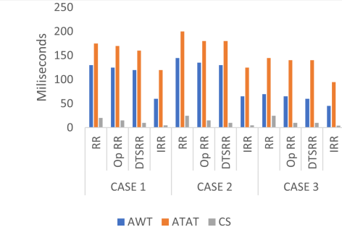
III. Performance-oriented
Comparison of process scheduling (i.e Linux CFS / windows 10)
Proposition of new algorithms
An Improved Round Robin Algorithm for an Efficient CPU Scheduling

Slide 8
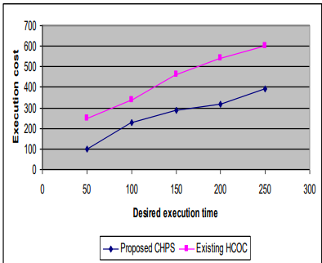
III. Energy-efficiency
Promote reliability, cost-effectiveness and extended battery life
Saving energy consumption
Regulates frequency utilization in the CPU
Balance between execution costs and execution time
Compatibility of Hybrid Process Scheduler in Green IT Cloud Computing Environment

Slide 9

III. Cyber-security
Create scheduling policies
Quantify the impact of cyber-attack in the schedulers
Consider the mitigation algorithms on schedulers
Create new algorithms to balance the impact when an attack is done

Slide 10
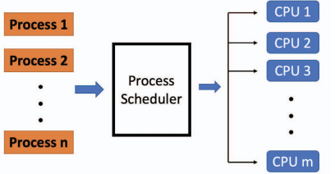
III. Multi-core oriented
Find the best way to balance the load between the cores
They try to improve performance and correctness
1 was the longest path first in (LPFI)
Can output result much faster than already existing algorithms
Scheduling in multi-core machine

Slide 11
Conclusion
General-Purpose
Performance
Energy
Efficiency
Cyber-security
Multi-core oriented
All targets problems encountered in HPC !

Slide 12
Thank you for your attention
Do you have any questions ?

Slide 13
References
Jack Tigar Humphries, Neel Natu, Ashwin Chaugule, Ofir Weisse, Barret Rhoden, Josh Don, Luigi Rizzo, Oleg Rombakh, Paul Turner, and Christos Kozyrakis. 2021. ghOSt: Fast & Flexible User-Space Delegation of Linux Scheduling. In ACM SIGOPS 28th Symposium on Operating Systems Principles (SOSP ’21), October 26–28, 2021, Virtual Event, Germany. ACM, New York, NY, USA, 17 pages. https: //doi.org/10.1145/3477132.3483542
Agarwal, Harshit & Jariwala, Gaurav. (2020). Analysis of Process Scheduling Using Neural Network in Operating System. 10.1007/978-981-15-0146-3_97.
Butt, M.A., Akram, M. A new intuitionistic fuzzy rule-based decision-making system for an operating system process scheduler. SpringerPlus 5, 1547 (2016). https://doi.org/10.1186/s40064-016-3216-z
Kulkarni, Nahush & Mahajan, Sameer & Patil, Adwait. (2020). IRJET | A Study of Available Process Scheduling Algorithms and Their Improved Substitutes. 7. 4129-4136.
W. -C. Fan, C. -S. Wong, W. -K. Lee and S. -O. Hwang, "Comparison of Interactivity Performance of Linux CFS and Windows 10 CPU Schedulers," 2020 International Conference on Green and Human Information Technology (ICGHIT), Hanoi, Vietnam, 2020, pp. 31-34, doi: 10.1109/ICGHIT49656.2020.00014.
A. M. Oshani Bandara and U. U. Samantha Rajapaksha, "An Improved Round Robin Algorithm for an Efficient CPU Scheduling," 2022 2nd International Conference on Advanced Research in Computing (ICARC), Belihuloya, Sri Lanka, 2022, pp. 349-354, doi: 10.1109/ICARC54489.2022.9754037.
Teng Ma, Shanpei Chen, Yihao Wu, Erwei Deng, Zhuo Song, Quan Chen, and Minyi Guo. 2023. Efficient Scheduler Live Update for Linux Kernel with Modularization. In Proceedings of the 28th ACM International Conference on Architectural Support for Programming Languages and Operating Systems, Volume 3 (ASPLOS 2023). Association for Computing Machinery, New York, NY, USA, 194–207. https://doi.org/10.1145/3582016.3582054
A. M. Oshani Bandara and U. U. Samantha Rajapaksha, "An Improved Round Robin Algorithm for an Efficient CPU Scheduling," 2022 2nd International Conference on Advanced Research in Computing (ICARC), Belihuloya, Sri Lanka, 2022, pp. 349-354, doi: 10.1109/ICARC54489.2022.9754037.
Giridas, K. & Nargunam, Shajin. (2012). Compatibility of Hybrid Process Scheduler in Green IT Cloud Computing Environment. International Journal of Computer Applications. 55. 27-33. 10.5120/8753-2649.
S. Z. Sheikh and M. A. Pasha, "Energy-Efficient Cache-Aware Scheduling on Heterogeneous Multicore Systems," in IEEE Transactions on Parallel and Distributed Systems, vol. 33, no. 1, pp. 206-217, 1 Jan. 2022, doi: 10.1109/TPDS.2021.3090587.
Evaluation of Dynamic Scheduling Policies against Cyber-attacks on an Open-Shop Manufacturing System using Simulation Alejandro Bracho Avila, Alireza Zarreh*, Can Saygin, Hung-Da Wan, Yooneun Lee The University of Texas at San Antonio, San Antonio, TX, Department of Mechanical Engineering Department of Electrical and Computer Engineering, Center for Advanced and Lean Systems (CAMLS) Received 20 June 2021, Accepted 15 Aug 2021, Available online 21 Aug 2021, Vol.9

Slide 14
References
X. Gao and M. Qiu, "Efficient Process Scheduling for Multi-core Systems," 2022 IEEE 8th Intl Conference on Big Data Security on Cloud (BigDataSecurity), IEEE Intl Conference on High Performance and Smart Computing, (HPSC) and IEEE Intl Conference on Intelligent Data and Security (IDS), Jinan, China, 2022, pp. 113-118, doi: 10.1109/BigDataSecurityHPSCIDS54978.2022.00030.
S. Song, Kai Hwang and Yu-Kwong Kwok, "Risk-resilient heuristics and genetic algorithms for security-assured grid job scheduling," in IEEE Transactions on Computers, vol. 55, no. 6, pp. 703-719, June 2006, doi: 10.1109/TC.2006.89.
K. Guha, S. Saha and K. McDonald-Maier, "SENAS: Security driven ENergy Aware Scheduler for Real Time Approximate Computing Tasks on Multi-Processor Systems," 2022 IEEE 28th International Symposium on On-Line Testing and Robust System Design (IOLTS), Torino, Italy, 2022, pp. 1-5, doi: 10.1109/IOLTS56730.2022.9897811.
S. Mohan, M. K. Yoon, R. Pellizzoni and R. Bobba, "Real-Time Systems Security through Scheduler Constraints," 2014 26th Euromicro Conference on Real-Time Systems, Madrid, Spain, 2014, pp. 129-140, doi: 10.1109/ECRTS.2014.28.
Tran, Giang Son & Nghiem, Thi & Ho, Tuong & Luong, Chi. (2016). Extended process scheduler for improving user experience in multi-core mobile systems. 417-424. 10.1145/3011077.3011106.
Muneeswari, G. & Shunmuganathan, K.. (2011). A Novel Hard-Soft Processor Affinity Scheduling for Multicore Architecture using Multiagents. European Journal of Scientific Research. 55.
C. E. Staniloiu, A. Militaru, R. Nitu and R. Deaconescu, "Safer Linux Kernel Modules Using the D Programming Language," in IEEE Access, vol. 10, pp. 134502-134511, 2022, doi: 10.1109/ACCESS.2022.3229461.

